Slide 1

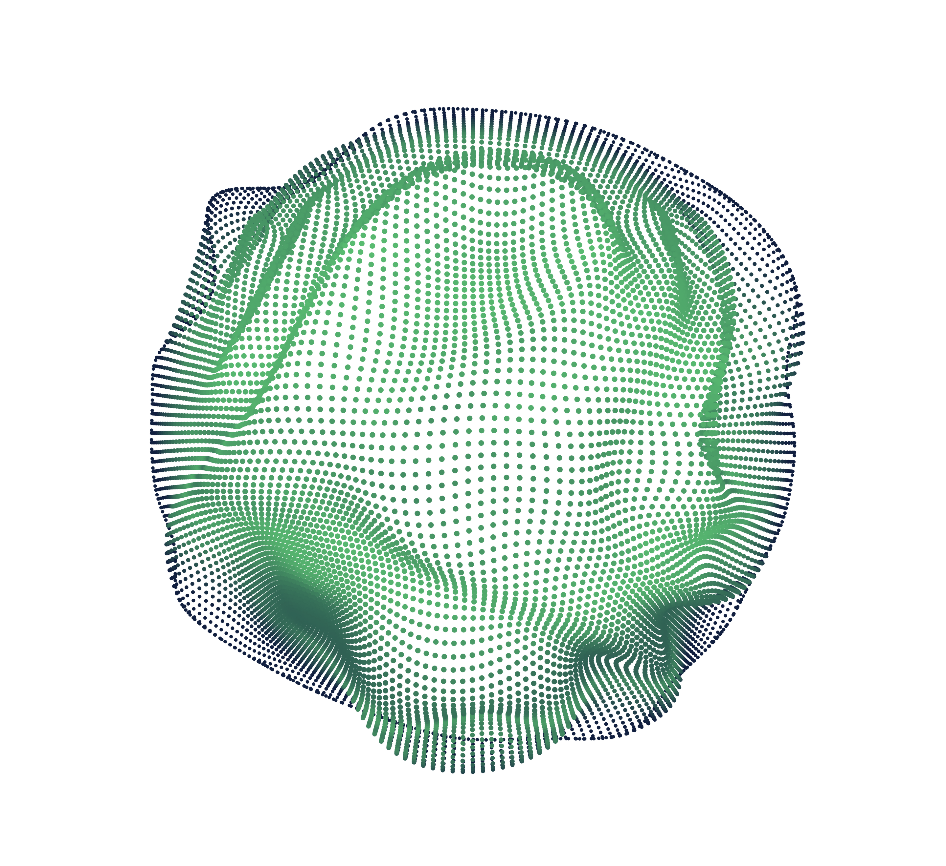

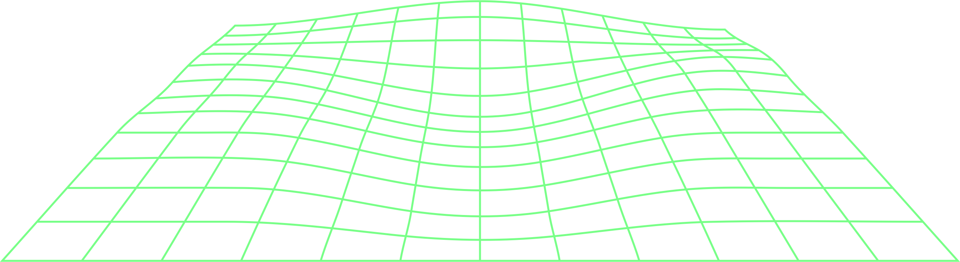
Analysis of
Machine Learning Models
For Image Classification on Cifar-10
Nicolae Mogage – ICA

Slide 2
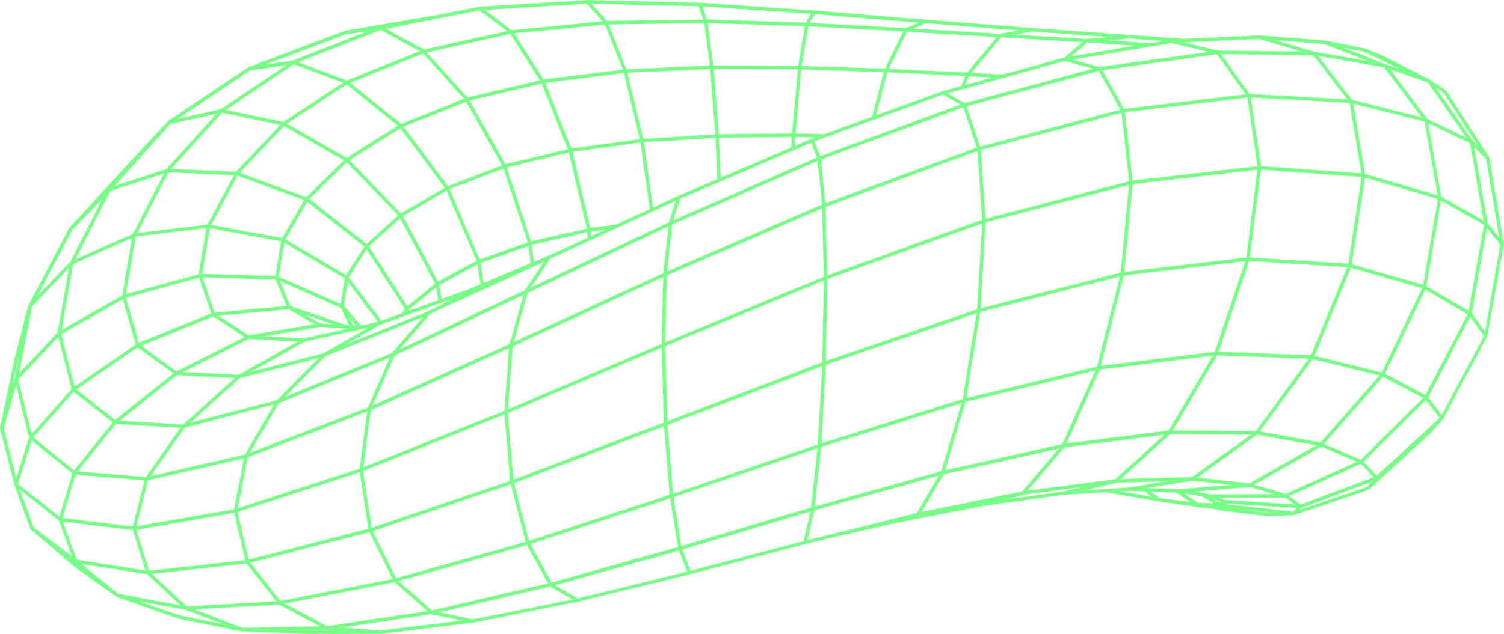
CONTENT
O
O
1
CIFAR-10
2
MODELS
O
O
3
EXPERIMENTS
4
CONCLUSIONS

Slide 3

↖ ↗
↘ ↙
1
CIFAR-10

Slide 4
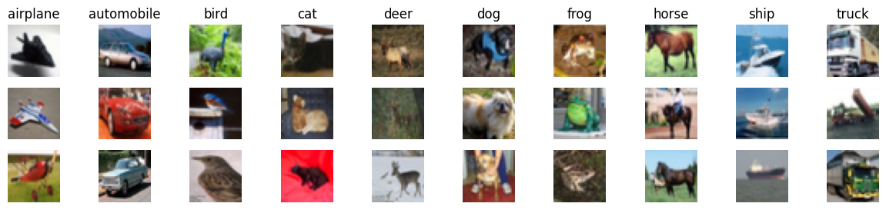
Dataset instances

Slide 5
↖ ↗
↘ ↙
2
Methods

Slide 6
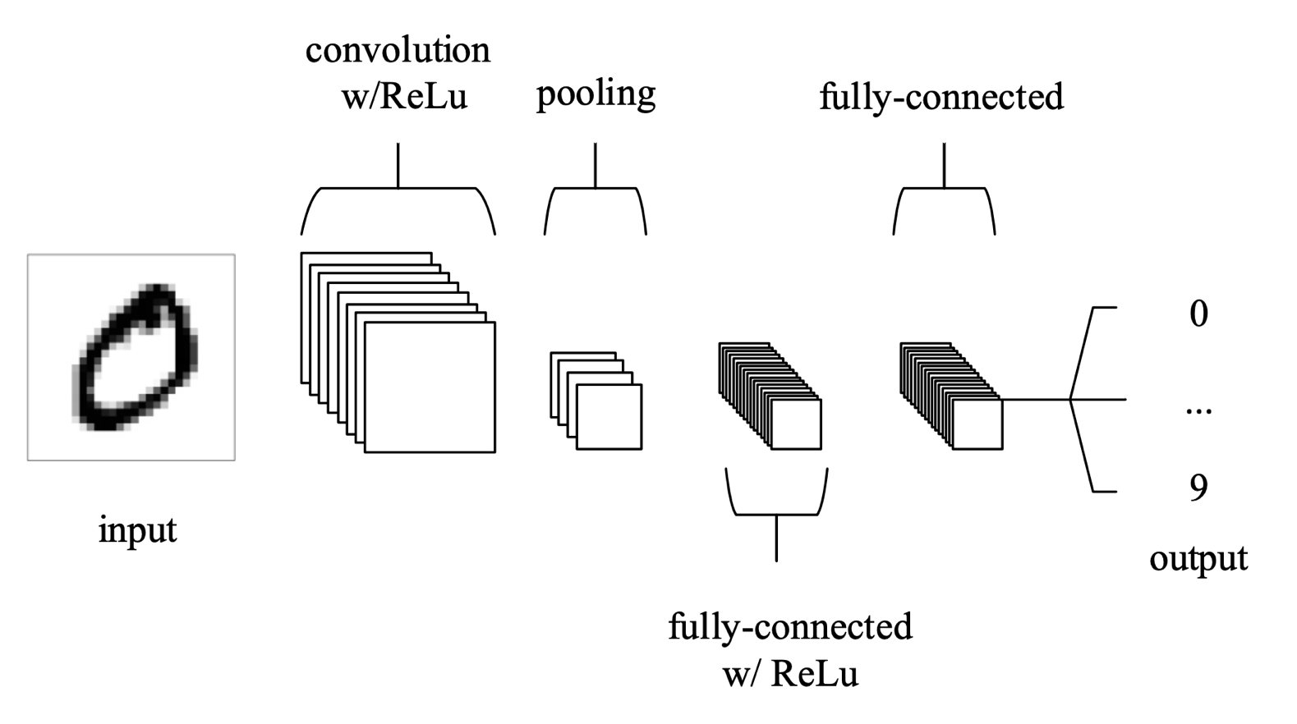
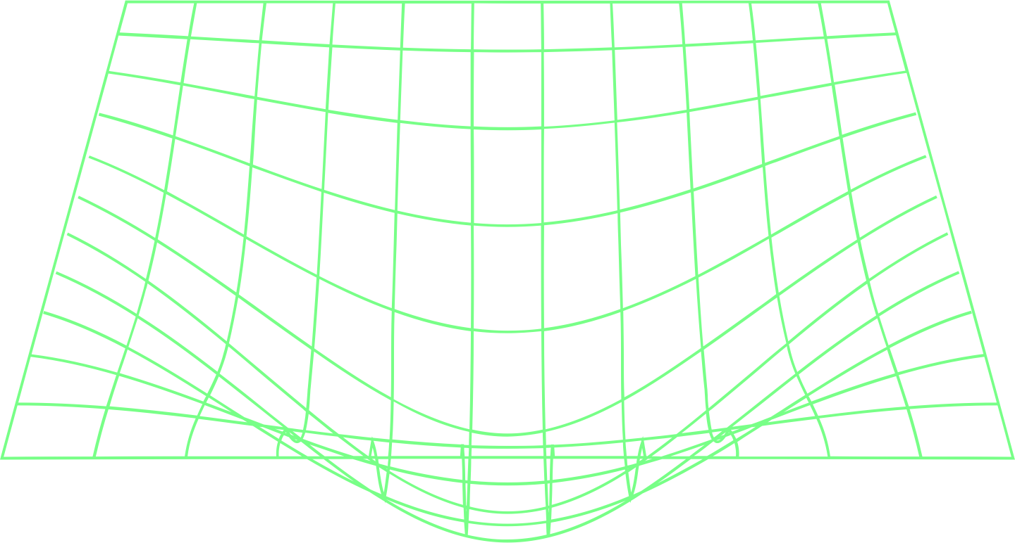
Convolutional Neuronal Networks

Slide 7
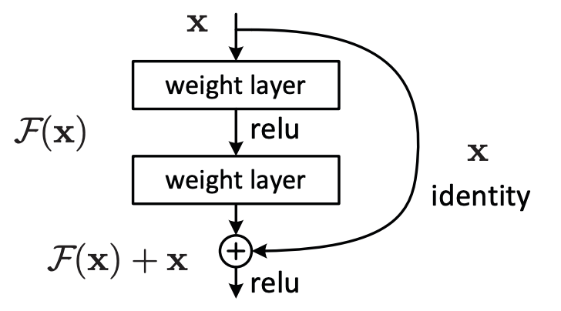
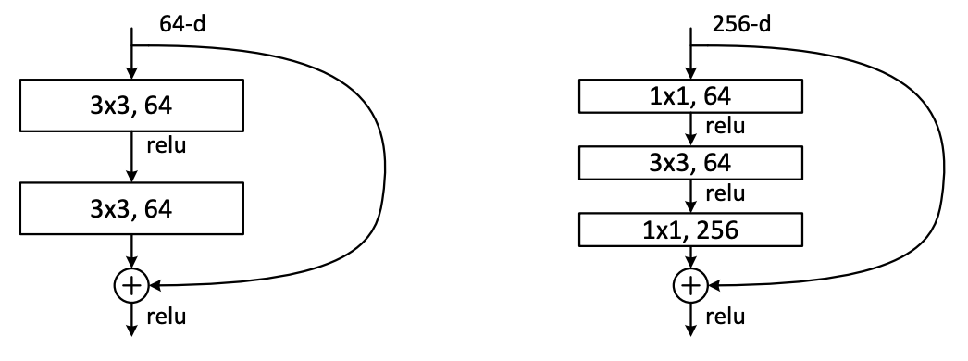
Deep Residual Networks
Building Block
Residual vs Bottleneck Blocks

Slide 8
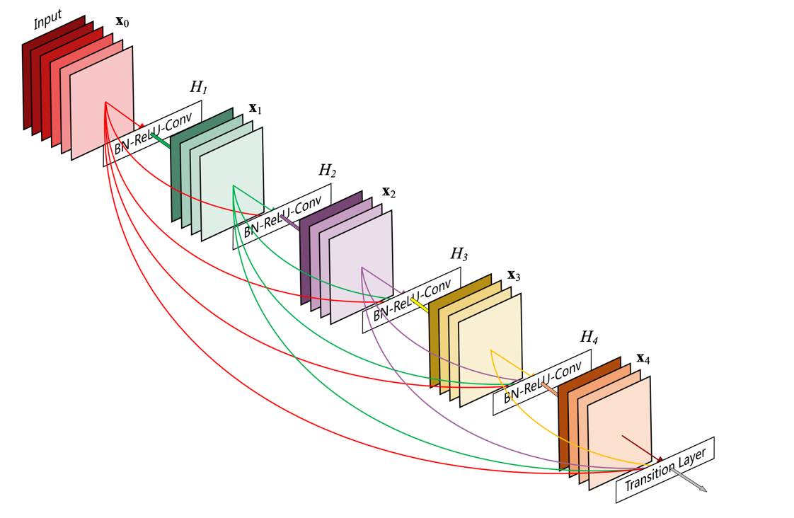
Densely Connected Convolutional Networks
Dense Block

Slide 9
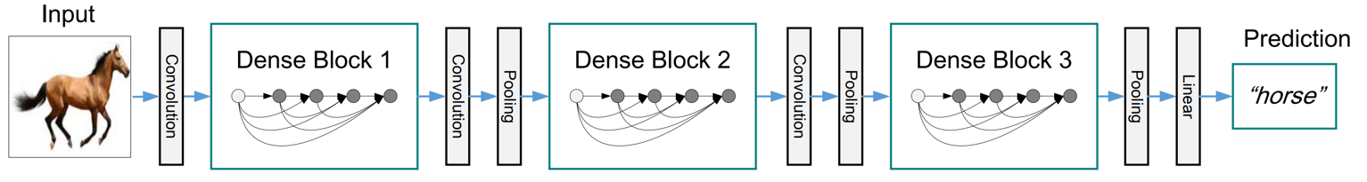
Densely Connected Convolutional Networks
DenseNet Architecture

Slide 10
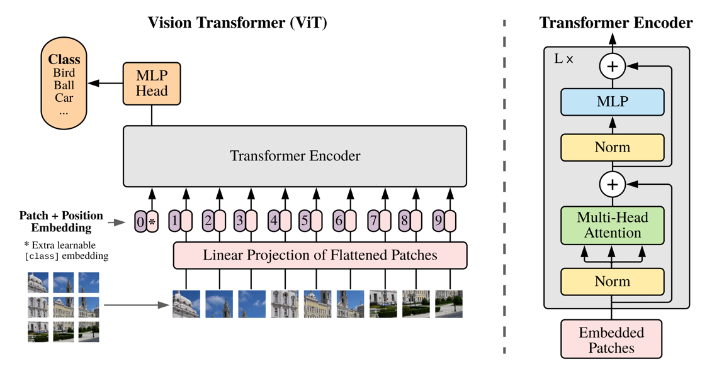
Vision Transformers

Slide 11
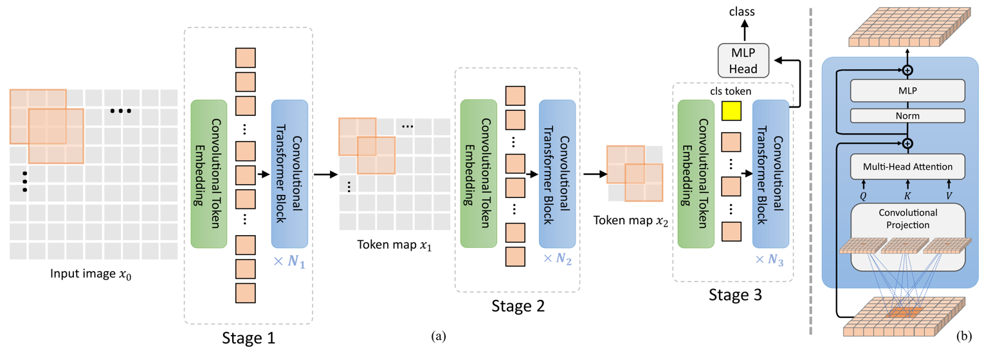
Convolutional Vision Transformers

Slide 12
↖ ↗
↘ ↙
3
Experiments

Slide 13

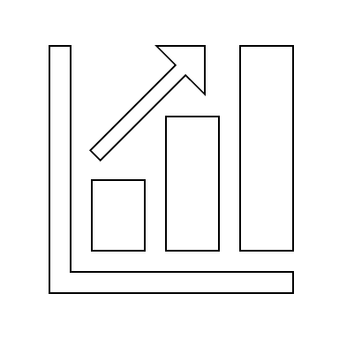

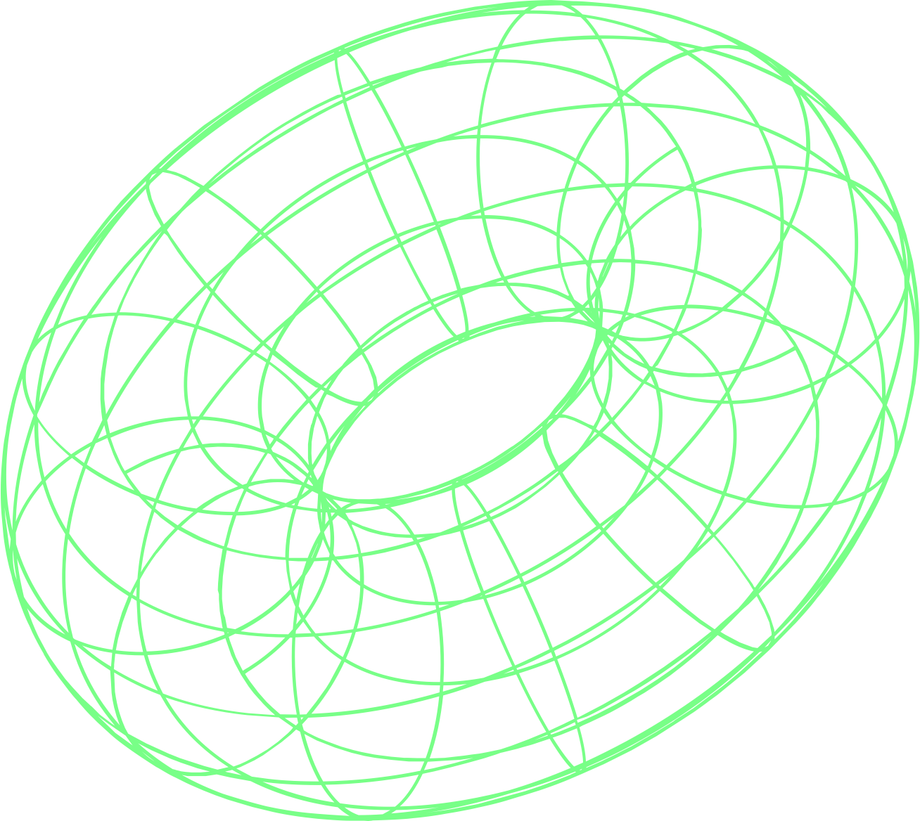
Setup
Models
Functions
Metrics

Slide 14
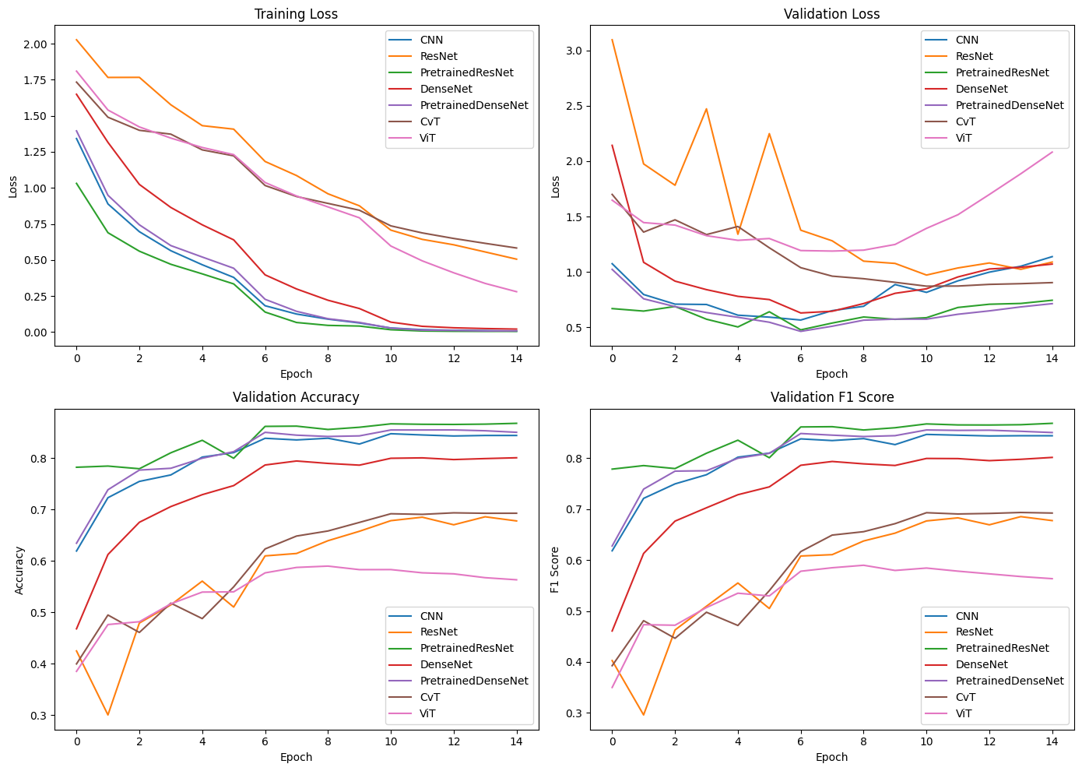
Losses

Slide 15
Validation metrics

Slide 16
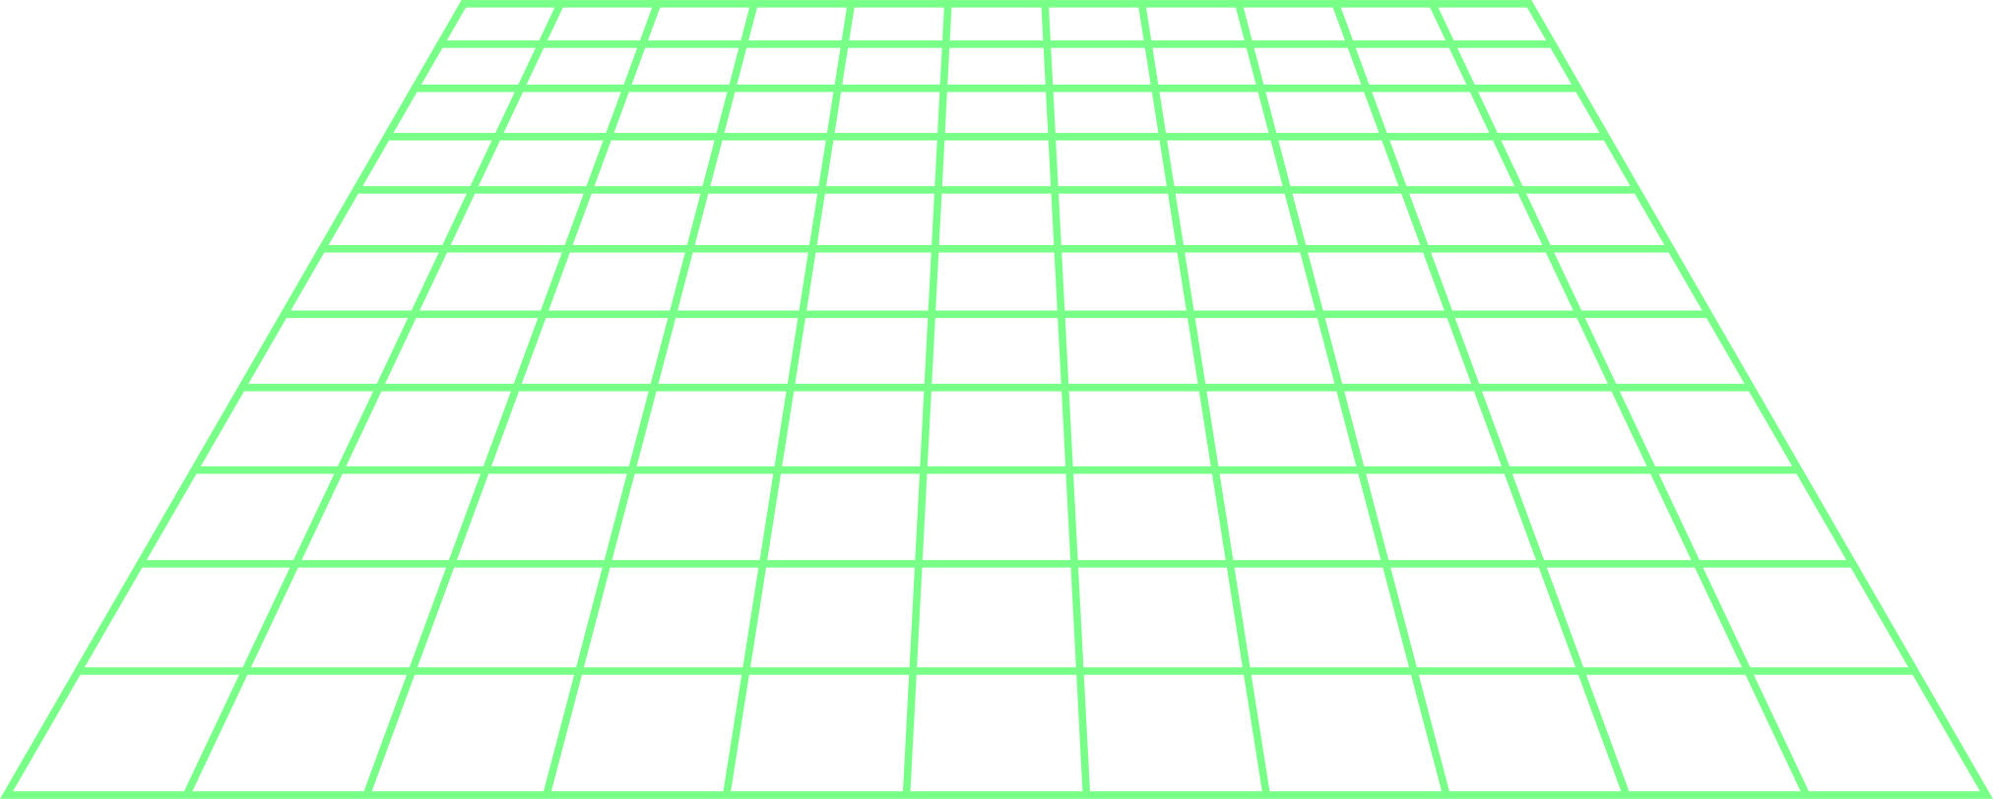
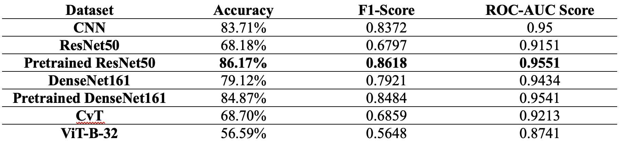
Results

Slide 17
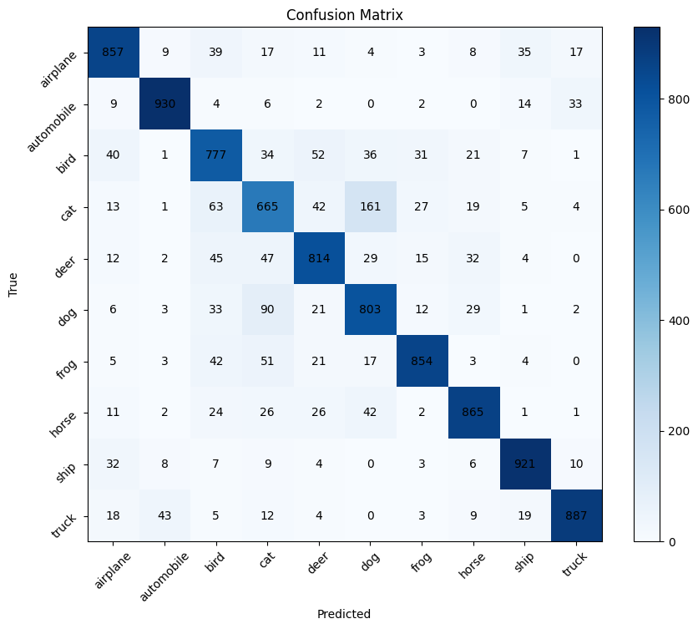
Confusion Matrix – CNN

Slide 18
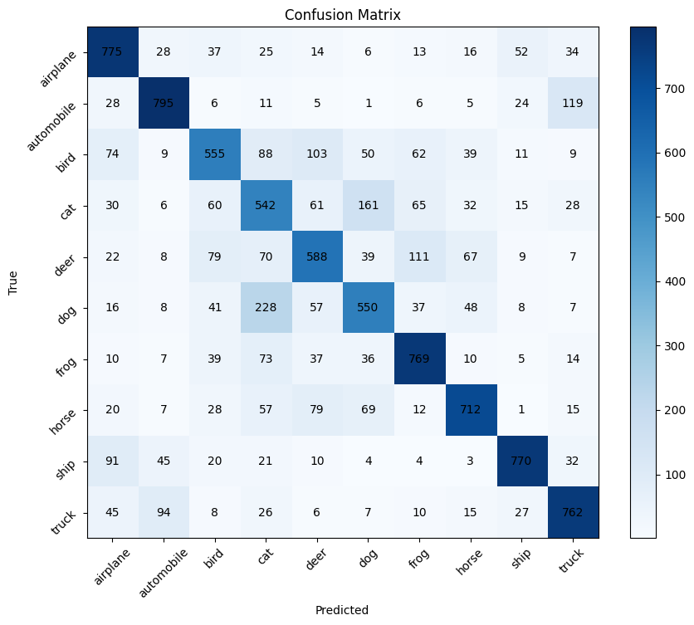
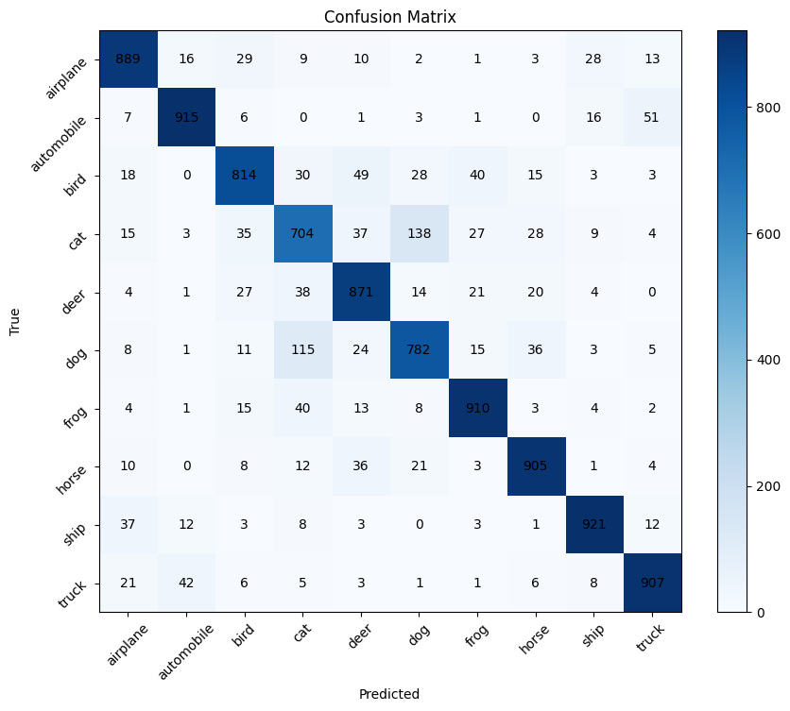
Confusion Matrix – ResNet
scratch
pretrained

Slide 19

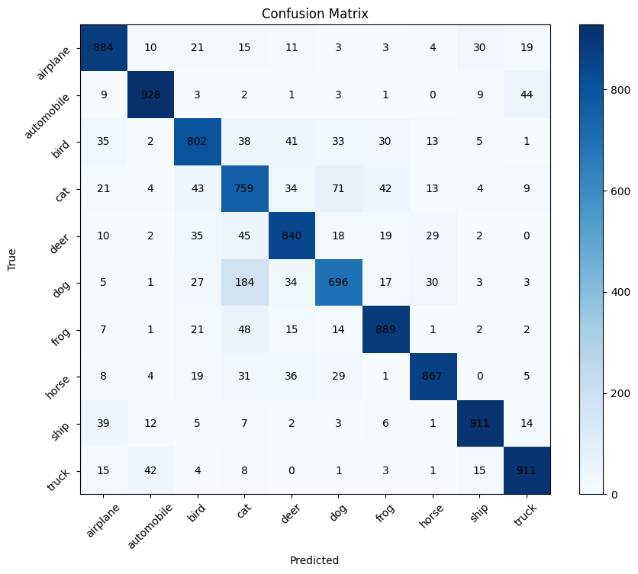
Confusion Matrix – DenseNet
scratch
pretrained

Slide 20
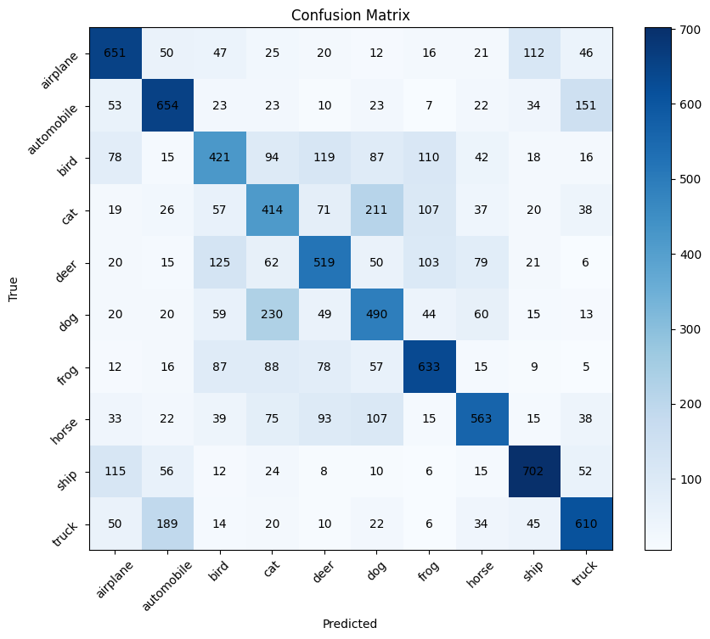
Confusion Matrix – ViT

Slide 21
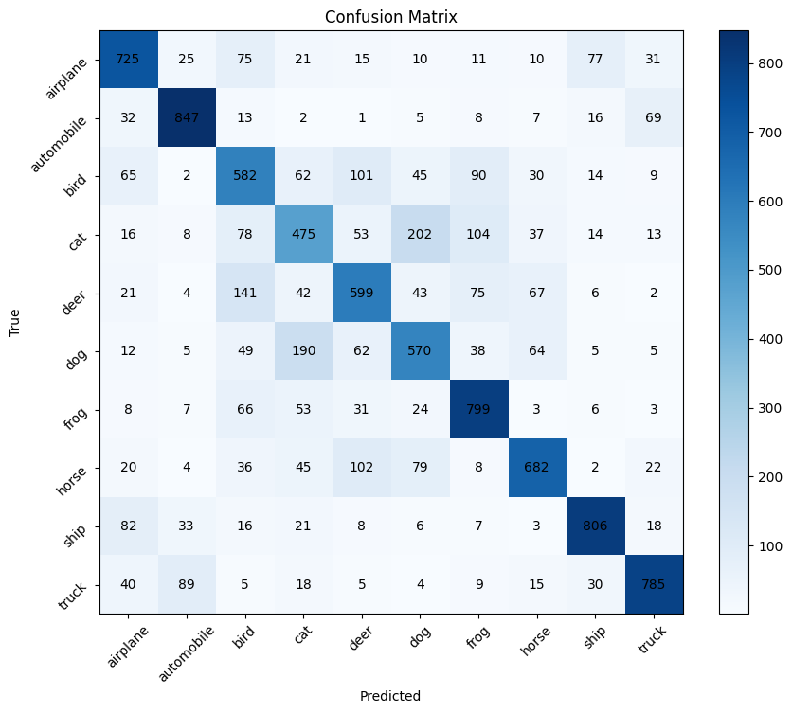
Confusion Matrix – CvT

Slide 22
↖ ↗
↘ ↙
4
Conclusions

Slide 23
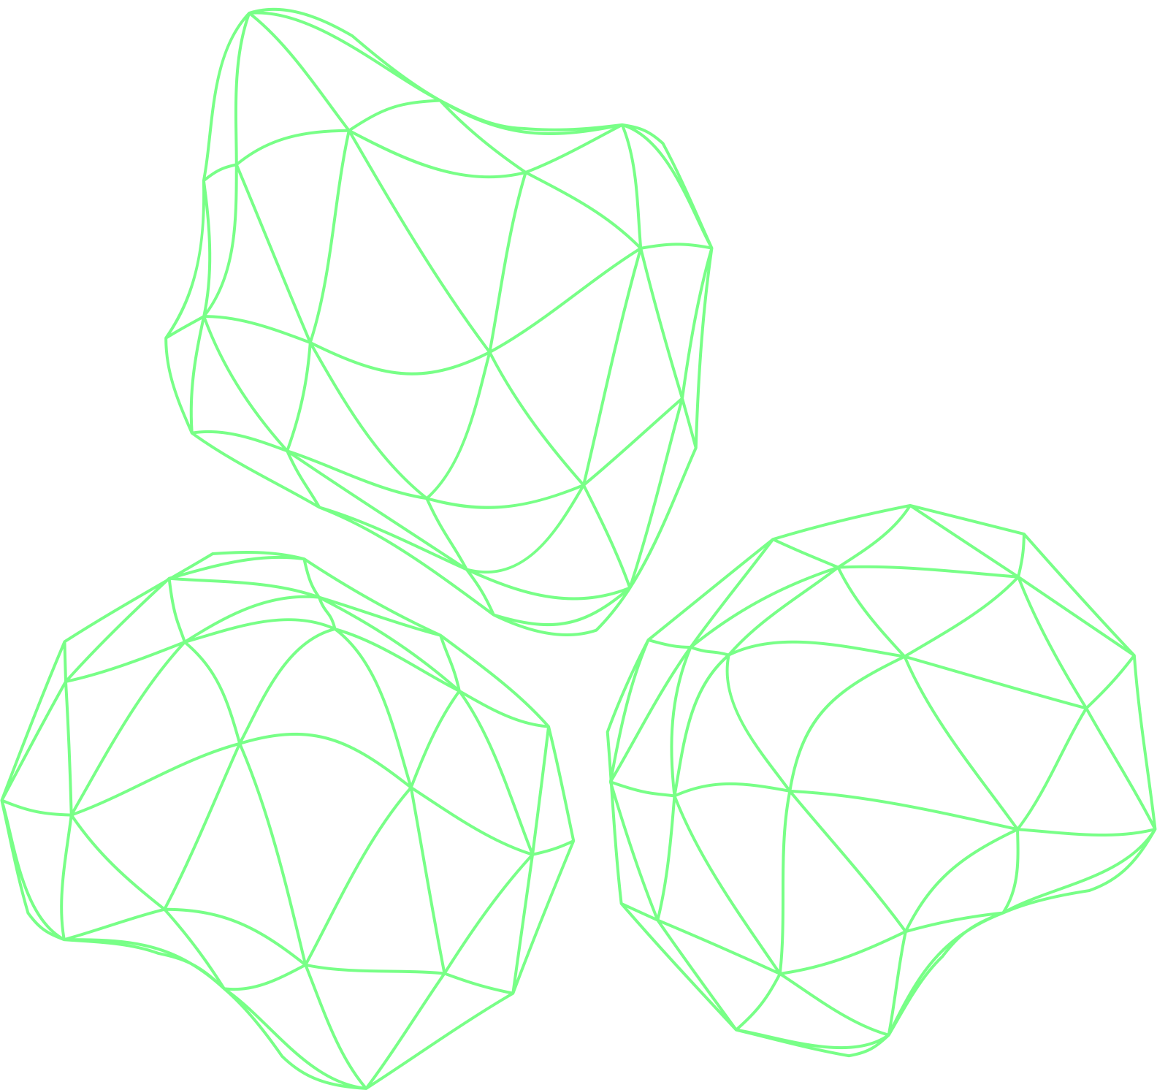
THANK YOU!

